Slide 1
Class 8
BUS 696
Prof. Jonathan Hersh

Slide 2
BUS 696: Class 8 Announcements
Pset 6 solutions
Problem Set 7 Posted
Final Project
Tell me about your projects
Qs?
Reminder: midterm exam in two weeks
Qs?
Any other Questions?

Slide 3
BUS 696: Class 8 Outline
AI in the News
Lasso Regression
Lasso Estimation
Comparing Lasso and Ridge
ElasticNet theory
Estimating ElasticNet Model

Slide 4

AI in the News

Slide 5
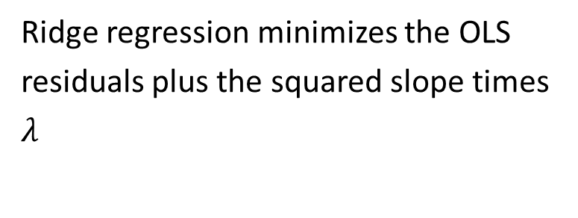
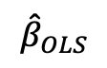
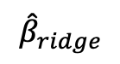
Ridge Regression Summary
$${\hat{β}}_{ridge}minimizes:{residuals+λ⋅{\left(slope\right)}^{2}}$$
Ridge regression minimizes the OLS residuals plus the squared slope times $λ$
$${\hat{β}}_{OLS}$$
$${\hat{β}}_{ridge}$$
Y
Idea: we accept a little bias (higher residuals) for less variance (better test performance)
X

Slide 6
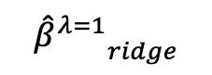
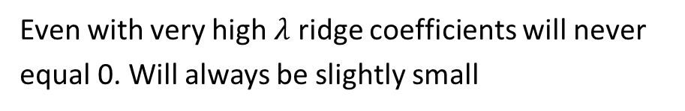

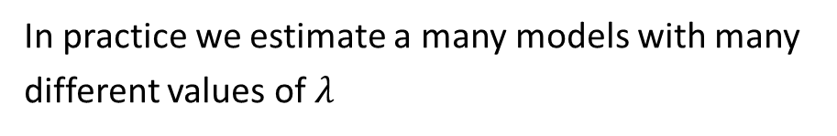
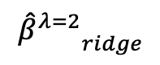
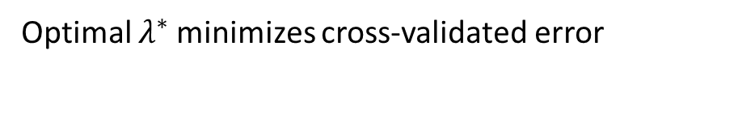
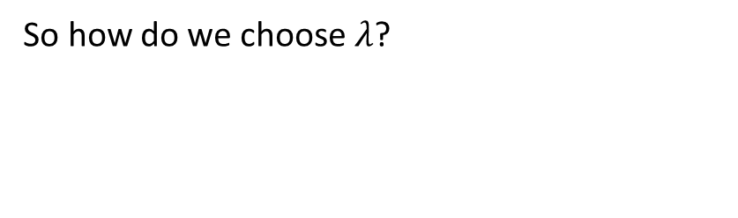
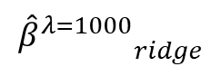
Larger $λ$ => More Penalization, Smaller Coefficients
$${\hat{β}}_{ridge}minimizes:{residuals+λ⋅{\left(slope\right)}^{2}}$$
So how do we choose $λ$?
In practice we estimate a many models with many different values of $λ$
$${{\hat{β}}^{λ=1}}_{ridge}$$
$${{\hat{β}}^{λ=2}}_{ridge}$$
Y
$${{\hat{β}}^{λ=1000}}_{ridge}$$
We pick a min and max lambda (say 0 and 1000), then choose some points in-between
Optimal $λ^{∗}$ minimizes cross-validated error
X
Even with very high $λ$ ridge coefficients will never equal 0. Will always be slightly small

Slide 7
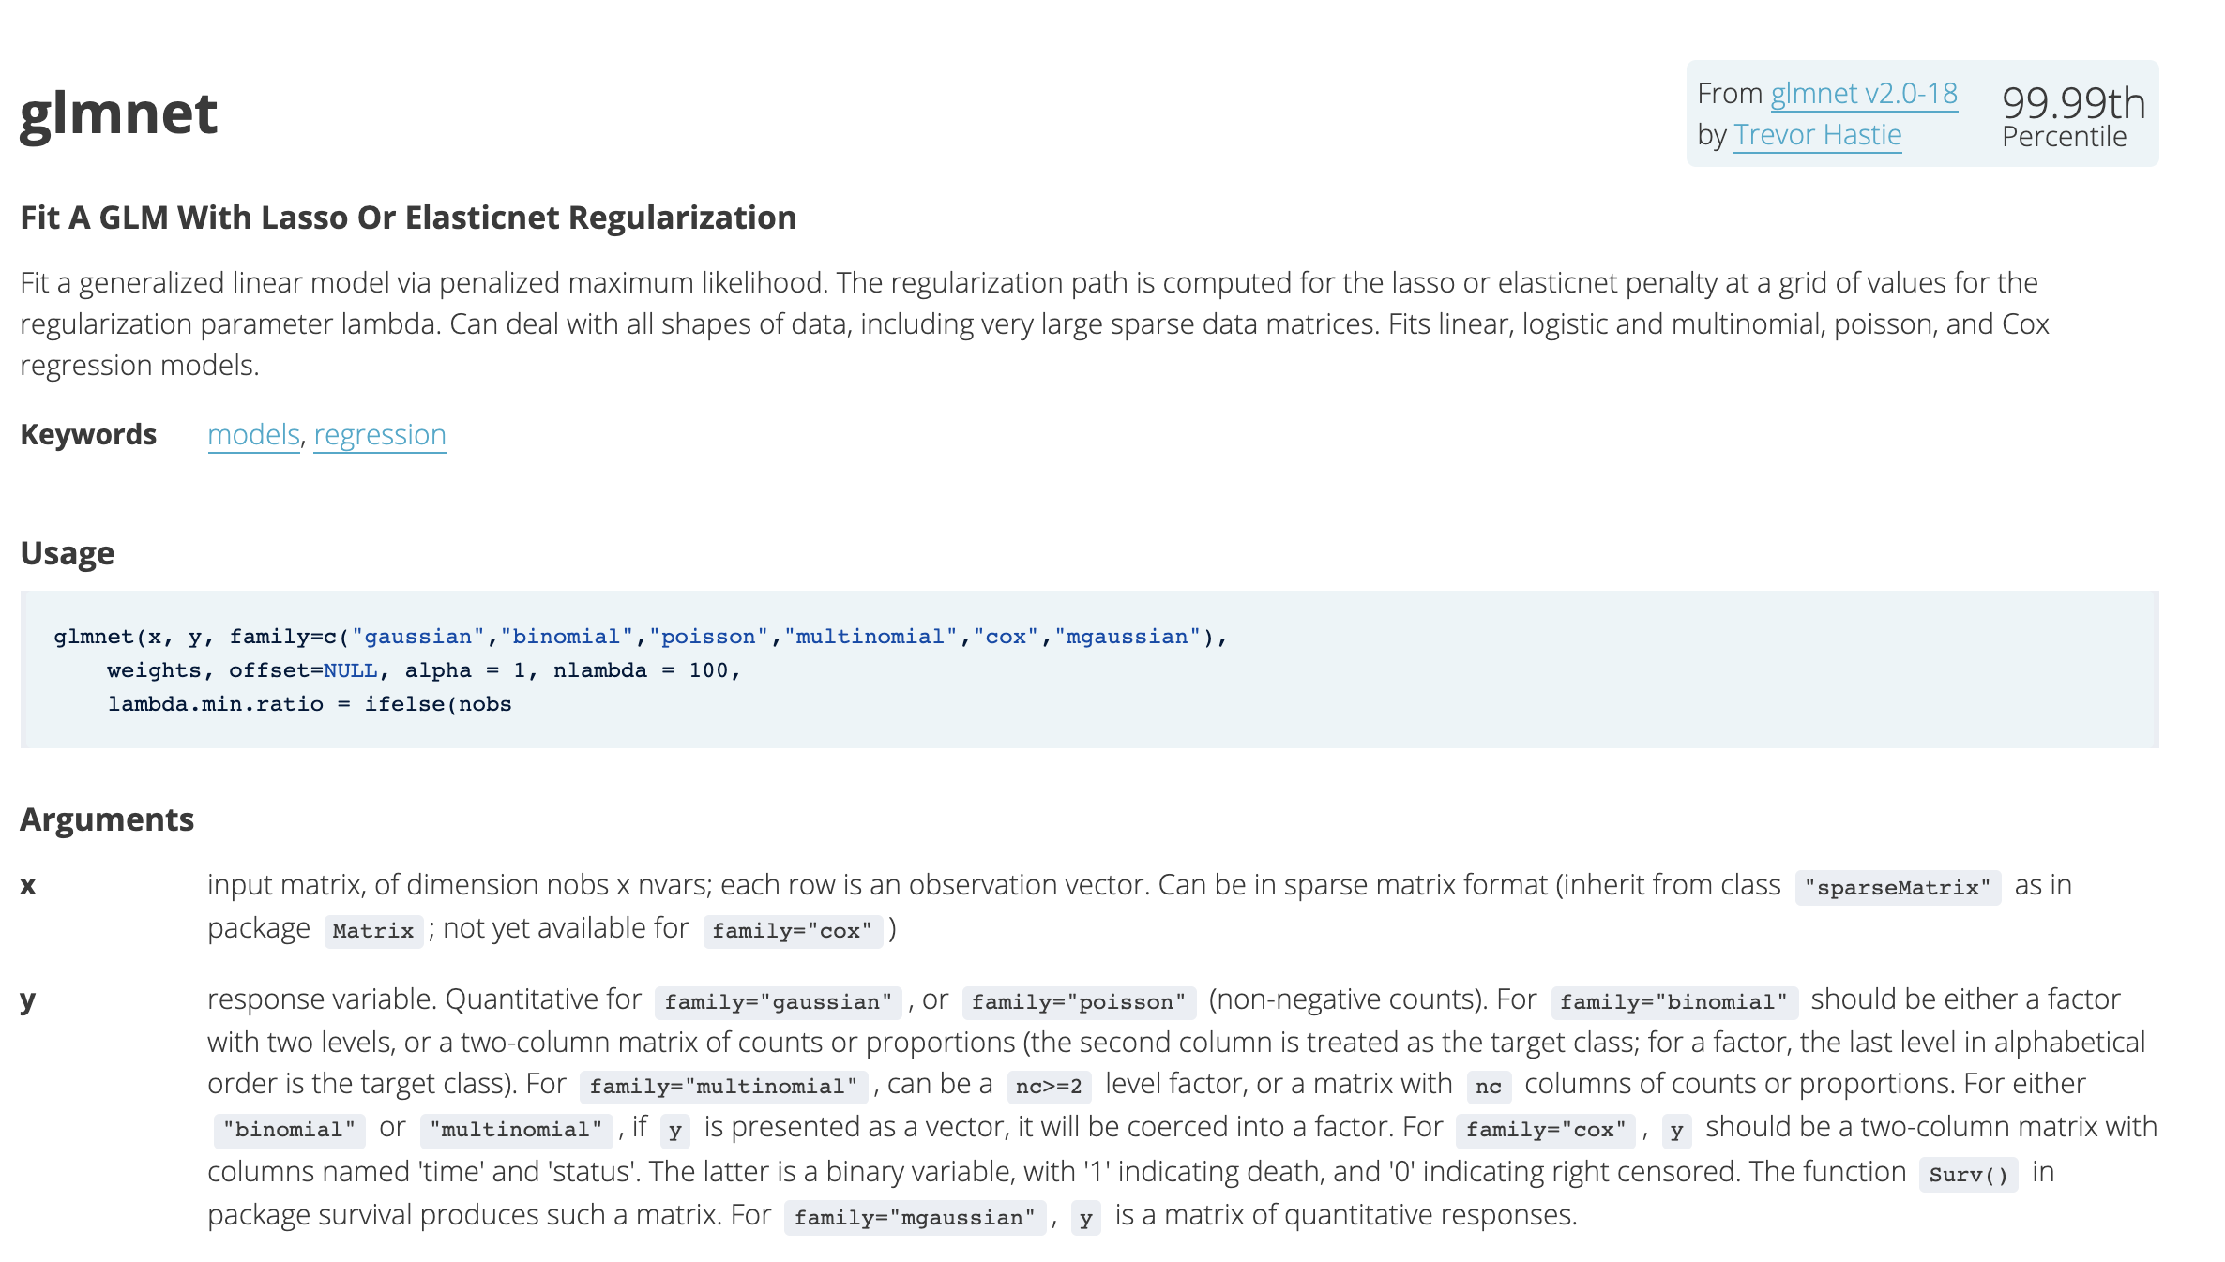
glmnet package

Slide 8
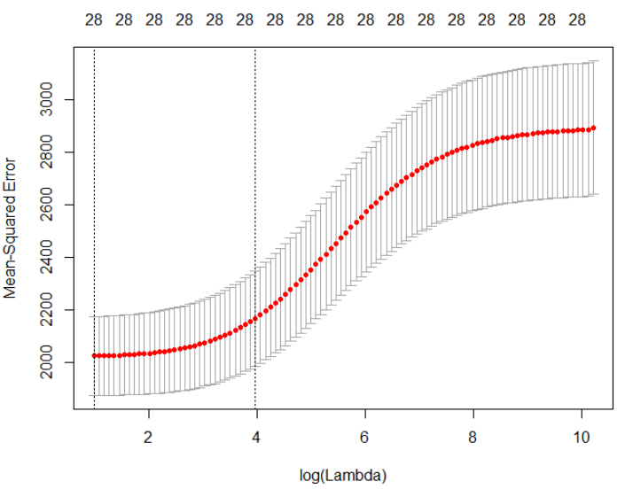
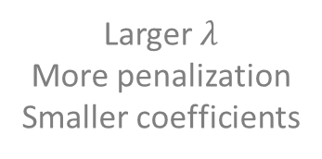
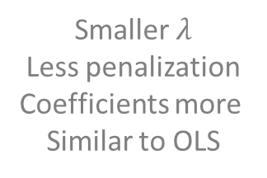
Cross-Validated MSE Plot As A Function of Lambda
Lambda.1se
Lambda.min
Smaller $λ$
Less penalization
Coefficients more
Similar to OLS
Larger $λ$
More penalization
Smaller coefficients

Slide 9
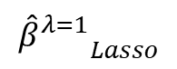
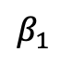
Lasso Regression Idea
$${\hat{β}}_{Lasso}minimizes:{residuals+λ⋅\left( \left|β_{1}\right|+\left|β_{2}\right|+…+|β_{k}| \right) }$$
Lasso minimizes the residuals plus lambda times the absolute value of the slope coefficients
$β_{1}$
$${{\hat{β}}^{λ=1}}_{Lasso}$$
Lasso coefficients are still smaller than OLS coefficients
Y
Lasso still accepts a little bias for (hopefully) less variance
X

Slide 10
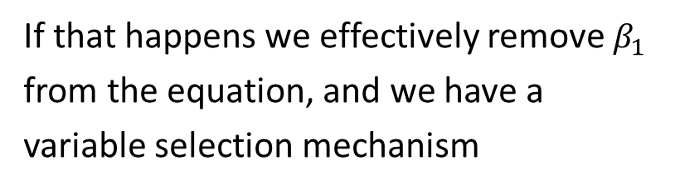

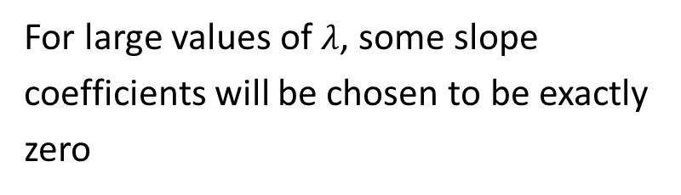
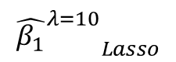
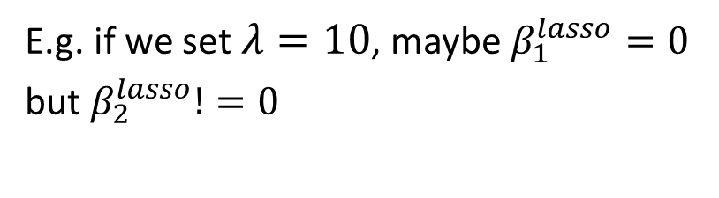
Key Lasso Property: Variable Selection
$${\hat{β}}_{Lasso}minimizes:{residuals+λ⋅\left( \left|β_{1}\right|+\left|β_{2}\right|\right) }$$
For large values of $λ$, some slope coefficients will be chosen to be exactly zero
$β_{1}$
$${{\hat{β_{1}}}^{λ=10}}_{Lasso}$$
E.g. if we set $λ=10$, maybe $β_{1}^{lasso}=0$ but $β_{2}^{lasso}!=0$
Y
If that happens we effectively remove $β_{1}$ from the equation, and we have a variable selection mechanism
$$x_{1}$$

Slide 11
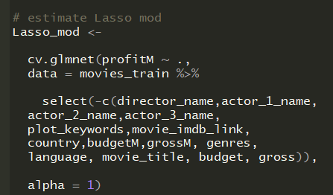
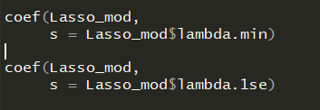
Estimating Lasso Model in R
The coef function outputs the coefficients for a specific lambda.

Slide 12
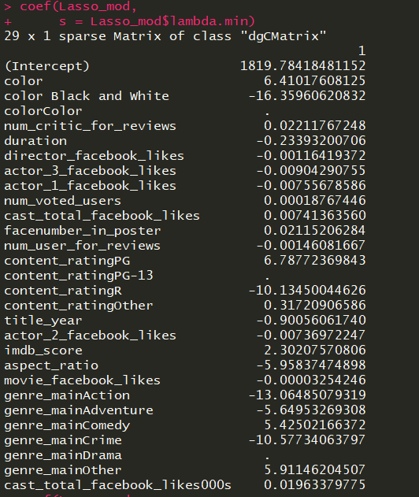
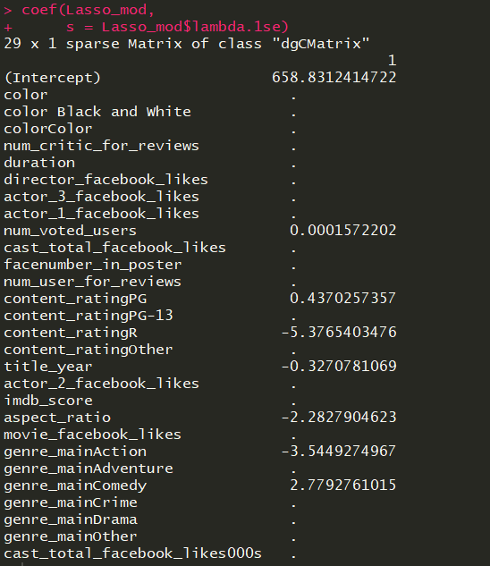
Lasso Coefficients Varying Lambda

Slide 13
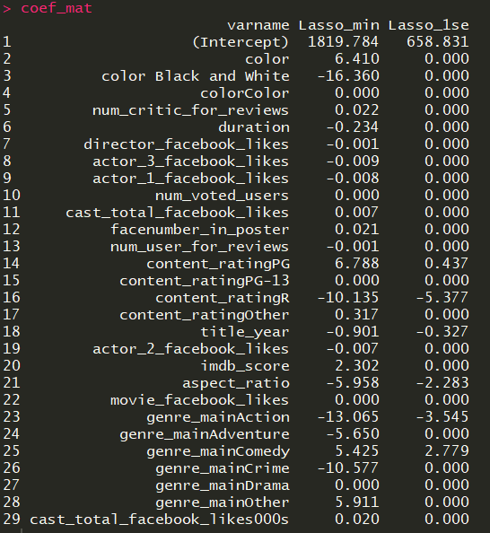
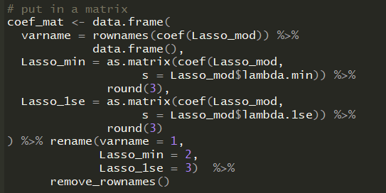
Make it a little prettier

Slide 14
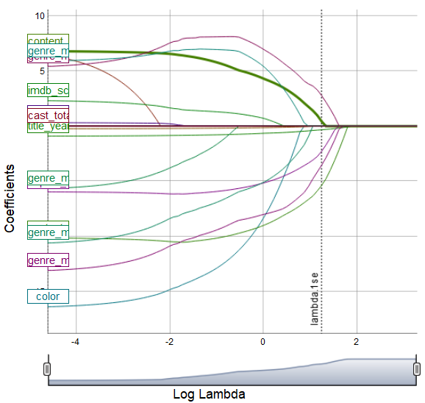
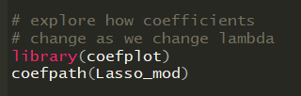
Coefpath to examine the shrinkage path

Slide 15
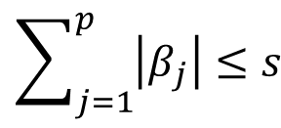
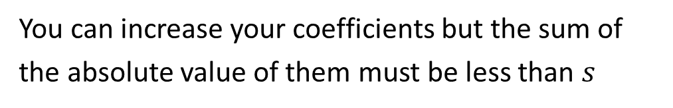
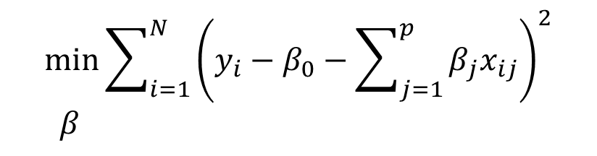

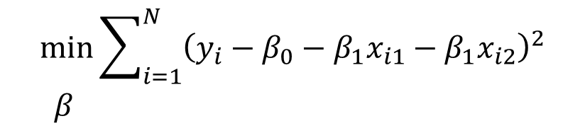
Another way to write Lasso
$$\min{\sum_{i=1}^{N}{{\left(y_{i}−β_{0}−\sum_{j=1}^{p}{β_{j}x_{ij}}\right)}^{2}}} \\ β$$
$$\sum_{j=1}^{p}{\left|β_{j}\right|≤s}$$
Lasso
subject to
Lasso with two variables
$$\min{\sum_{i=1}^{N}{{\left(y_{i}−β_{0}−β_{1}x_{i1}−β_{1}x_{i2}\right)}^{2}}} \\ β$$
subject to
$$\left|β_{1}\right|+\left|β_{2}\right|≤s$$
In other words: I give you $s$ as a budget (like setting some lambda)
You can increase your coefficients but the sum of the absolute value of them must be less than $s$

Slide 16
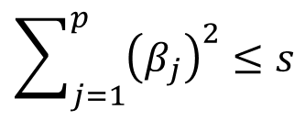
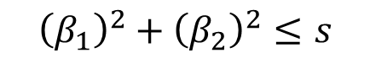
Another way to write Ridge
$$\min{\sum_{i=1}^{N}{{\left(y_{i}−β_{0}−\sum_{j=1}^{p}{β_{j}x_{ij}}\right)}^{2}}} \\ β$$
$$\sum_{j=1}^{p}{{\left(β_{j}\right)}^{2}≤s}$$
Ridge
subject to
Ridge with two variables
$$\min{\sum_{i=1}^{N}{{\left(y_{i}−β_{0}−β_{1}x_{i1}−β_{1}x_{i2}\right)}^{2}}} \\ β$$
subject to
$${\left(β_{1}\right)}^{2}+{\left(β_{2}\right)}^{2}≤s$$
In other words: I give you $s$ as a budget (like setting some lambda)
You can increase your coefficients but the sum of the absolute value of them must be less than $s$

Slide 17

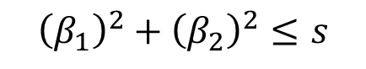
Ridge Versus Lasso Penalty
Ridge penalty
$${\left(β_{1}\right)}^{2}+{\left(β_{2}\right)}^{2}≤s$$
Lasso penalty
$$\left|β_{1}\right|+\left|β_{2}\right|≤s$$

Slide 18
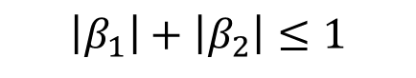
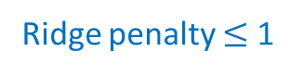
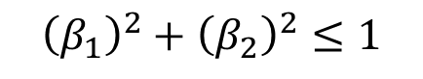
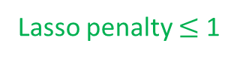
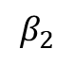
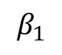
Ridge Versus Lasso Penalty
$$β_{2}$$
Ridge penalty
$${\left(β_{1}\right)}^{2}+{\left(β_{2}\right)}^{2}≤1$$
Lasso penalty
$$\left|β_{1}\right|+\left|β_{2}\right|≤1$$
$$β_{1}$$
Let’s pick an arbitrary value of s = 1
What do these look like graphically?
Lasso penalty $≤$ 1
Ridge penalty $≤$ 1

Slide 19
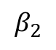
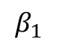
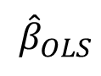
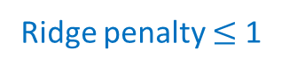
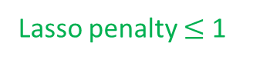
Ridge and Lasso Equations Redux
OLS residuals level curves
Suppose the optimal OLS beta is this point in black
$$β_{2}$$
$${\hat{β}}_{OLS}$$
Meaning, without constraints this point achieves a minimum of the residuals
We can represent that graphically as a series of contour lines where the black dot (OLS beta) is the minimum
$$β_{1}$$
Level curves farther from the OLS point are higher residuals
Ridge penalty $≤$ 1
Lasso penalty $≤$ 1

Slide 20
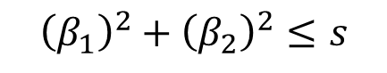
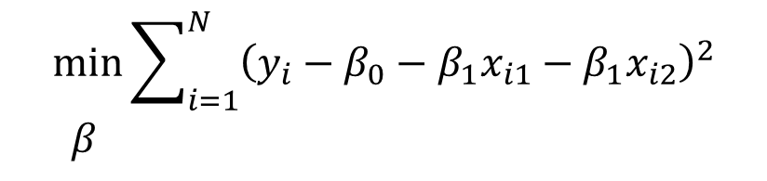
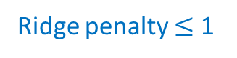
Ridge and Lasso Equations Redux
OLS residuals level curves
Graphically what the ridge equation is asking is: “find the lowest residual level curve while staying within the blue circle”
$$β_{2}$$
$${\hat{β}}_{OLS}$$
That is the level curve tangent to the blue line
$$β_{1}$$
$$\min{\sum_{i=1}^{N}{{\left(y_{i}−β_{0}−β_{1}x_{i1}−β_{1}x_{i2}\right)}^{2}}} \\ β$$
Ridge
subject to
$${\left(β_{1}\right)}^{2}+{\left(β_{2}\right)}^{2}≤s$$
Ridge penalty $≤$ 1
Lasso penalty $≤$ 1

Slide 21

Ridge and Lasso Equations Redux
OLS residuals level curves
Graphically what the Lasso equation is asking is: “find the lowest residual level curve while staying within the green diamond”
$$β_{2}$$
$${\hat{β}}_{OLS}$$
That is the level curve tangent to the green line
$$β_{1}$$
$$\min{\sum_{i=1}^{N}{{\left(y_{i}−β_{0}−β_{1}x_{i1}−β_{1}x_{i2}\right)}^{2}}} \\ β$$
Lasso
subject to
$$\left|β_{1}\right|+\left|β_{2}\right|≤s$$
Ridge penalty $≤$ 1
Lasso penalty $≤$ 1

Slide 22
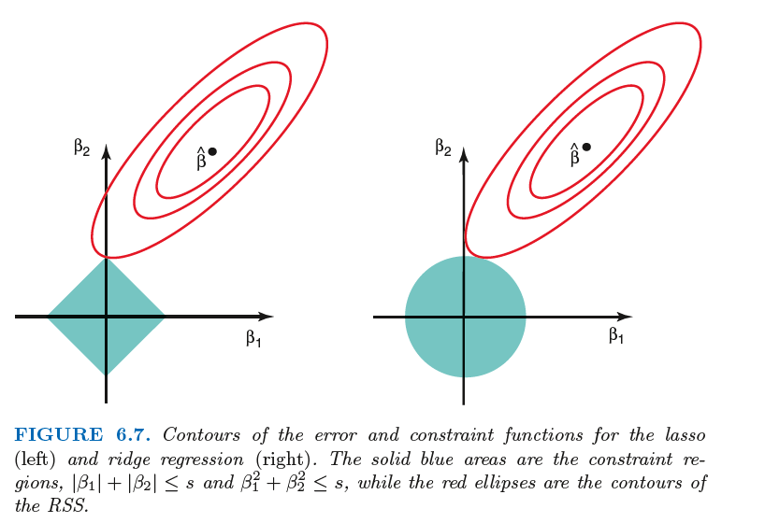
Ridge and Lasso Equations Redux
Lasso acts as a variable selector because the point of tangency for Lasso is often such that one of the variables (here beta_1) is zero
Ridge does not have this property, and we see there’s still some small value for beta_1 in the right plot

Slide 23


Ridge versus Lasso
Use Lasso when the “data generating process” (DGP, how the data is really formed) is sparse
What is a sparse DGP?
Only a few variables really matter!
Ridge should be used when many variables matter a little

Slide 24
BUS 696: Class 8 Outline
AI in the News
Lasso Regression
Lasso Estimation
Comparing Lasso and Ridge
ElasticNet theory
Estimating ElasticNet Model

Slide 25
Ridge and Lasso?
Why do we have to choose between ridge and Lasso?
Conceptually we could have both a squared and an absolute value penalty on the coefficients
That model is called the ElasticNet model

Slide 26

ElasticNet Equation
$${ β}_{ENet}=\underset{β}{argmin}\left\{\begin{matrix}\underset{OLS Sum of squared residuals}{\underbrace{\sum_{i=1 }^{N}{{\left(y_{i}−β_{0}−\sum_{j=1}^{K}{x_{ij}}β_{j}\right)}^{2}}}} & \begin{aligned} \\ λ\left[α \left(\sum_{j=1}^{p}{\left|β_{j}\right|}\right)+\left(1−α\right)\sum_{j=1}^{p}{{\left(β_{j}\right)}^{2} }\right]\end{aligned} & \end{matrix}\right\}$$
Let’s set p=2 (the number of variables) to make this easier to read

Slide 27



ElasticNet Equation
$${ β}_{ENet}=min⁡ \sum_{i=1}^{N}{{\left(y_{i}−β_{0}−β_{1}x_{i1}−β_{1}x_{i2}\right)}^{2}}$$
$$β$$
$$+ λ\left[α\left({|β}_{1}\right|+|β_{2}|)+(1−α)(β_{1}^{2}+β_{2}^{2})\right]$$
Lasso penalty
Ridge penalty
$α∈\left[0,1\right]$ controls the amount of ridge versus lasso penalty
$λ$ functions as before -> controlling total amount of shrinkage penalty

Slide 28




How to choose$λ$and $α?$ Grid Search
$${ β}_{ENet}=min⁡ \sum_{i=1}^{N}{{\left(y_{i}−β_{0}−β_{1}x_{i1}−β_{1}x_{i2}\right)}^{2}}$$
We try out a number of different combinations of hyper-parameters
$$β$$
$$+ λ\left[α\left({|β}_{1}\right|+|β_{2}|)+(1−α)(β_{1}^{2}+β_{2}^{2})\right]$$
For each hyper-parameter combination we calculate cross-validate MSE
$$λ$$ | $$α=0$$ | $$α=0.25$$ | $$α=0.5$$ | $$α=0.75$$ | $$α=1$$
0.5
1.0
1.5
2
0.1
1.1
1.1
1.1
1.1
1.1
1.1
1.1
1.1
1.1
1.1
1.1
1.1
1.1
Optimal combination has lowest cross-validated MSE
1.1
1.1
1.1
1.1
1.1
1.1

Slide 29

ElasticNet in R

Slide 30

ElasticNet in R

Slide 31




ElasticNet in R

Slide 32

ninlossplot(enet_fit) to view CV error against alpha
The package doesn’t automatically choose alpha for us, because this is a noisy statistical process -> hard to optimize
Consider multiple alphas if they are close together due to noisy error estimation
Ridge
Lasso
More Ridge penalty
More Lasso penalty

Slide 33

plot(enet_fit) to view CV-MSE across alphas
Package doesn’t label these plots (it should) but the darker ones have alphas closer to 1
Ridge
(alpha = 0)
Lasso (alpha = 1)
Taken together, we can surmise Lasso should do best with this data, but we can re-estimate to ensure alpha =0.75 isn’t best

Slide 34


plot(enet_fit$modlist[[#]]) stores individual models
Alpha = 0.75 model

Slide 35


coef(mod) must specify alpha

Slide 36


coef(mod) must specify alpha

Slide 37


Compare coefficients across alphas

